Slide 1
The what and how in fmt.Println()
It’s just printing.
2023.6.29
Edward Lin
Notes:
自介：後端工程師
Go is a self-hosting language
看了大家希望的題目之後，看到有人問說怎麼開始讀Source Code
用大家（只要是會Go的人）都很常用到的function來舉例

Slide 2

Printing something
What’s the desired printing content?
What’s the tool we are planning to use?
Print something our tool recognize
Print something our tool doesn’t recognize
What’s the desired printing destination?
Notes:
Explain how you print things in real life
7-11影印機（黑白，彩色，貼紙）-> 材料：紙，輸出：紙
3D printer -> 材料：塑膠, 輸出：完成品

Slide 3
Hello, World!

Slide 4
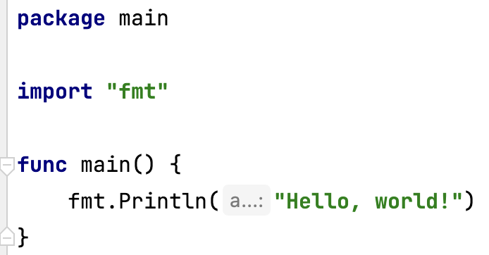
Well, Hello World!
Notes:
這應該是所有學程式的人的第一句話吧（雖然可能不是用Go)

Slide 5
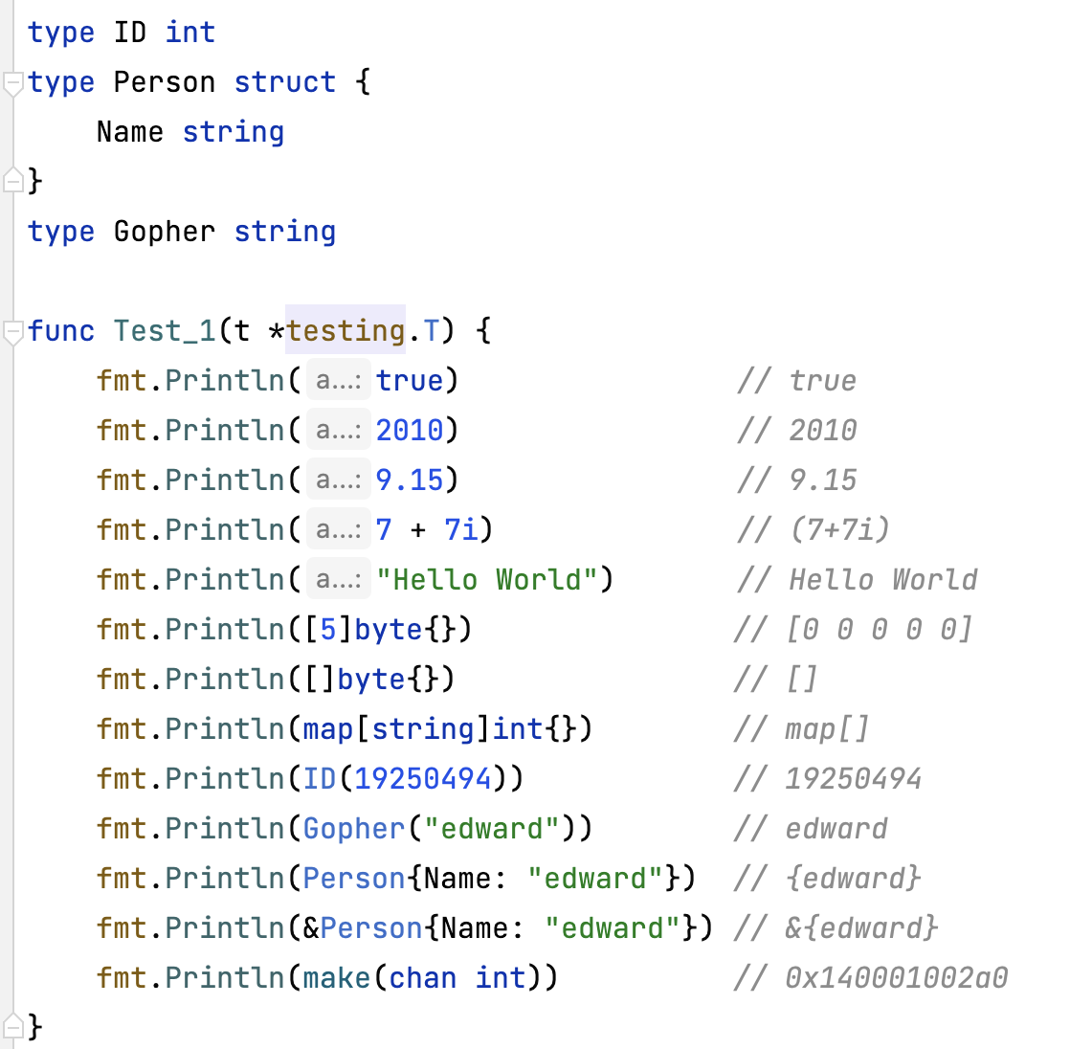
Content
Destination: Terminal
But why?
Think for a moment, what are the printing results?
Notes:
用剛剛的影印機的邏輯，我現在要印一大堆東西，每個都有不同的格式，請問他們應該輸出什麼呢？
輸入 -> 工具 -> 輸出
Why it the result the result? Well, we have to check the fmt package from the standard library.

Slide 6
The Standard Library

Slide 7
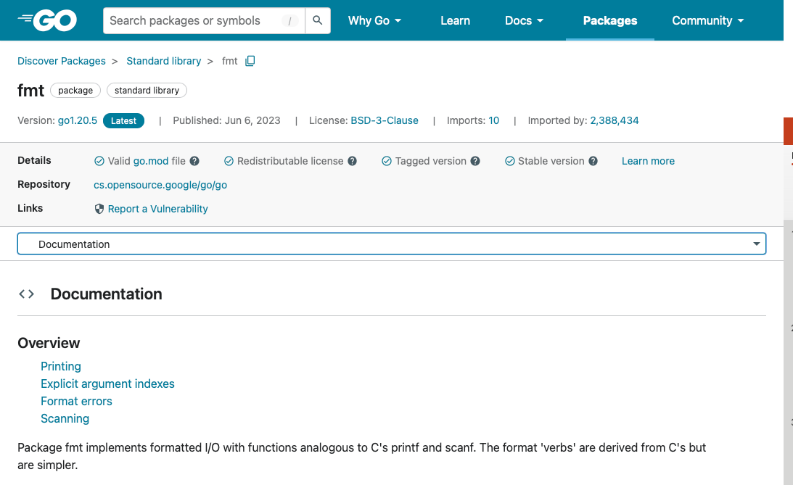
The Tool:
fmt package
Notes:
Version
Imported by …
Overview

Slide 8
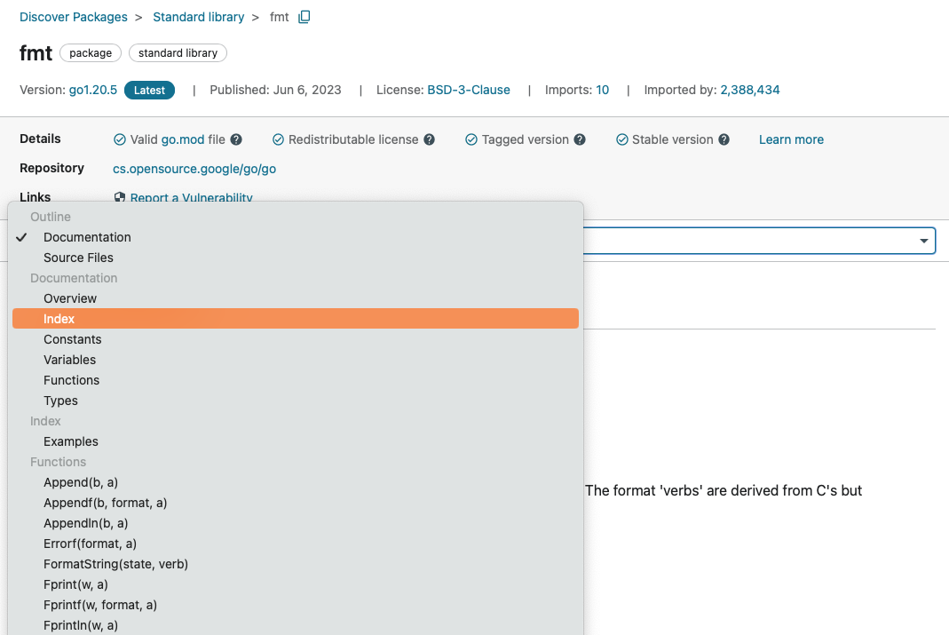
Index

Slide 9
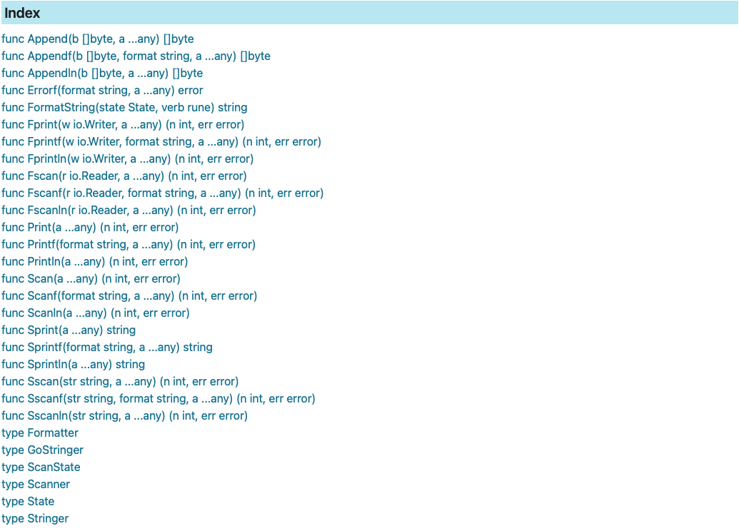
Index
Notes:
常常一大堆，在哪呢（有看到嗎）
找到啦

Slide 10
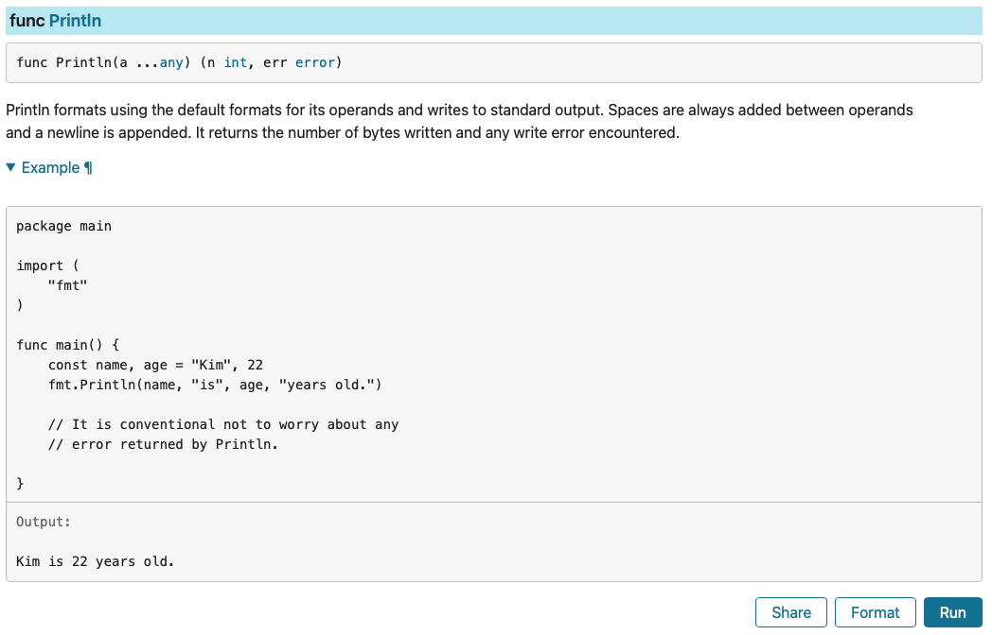
func Println(a… any) (n int, err error)
Format the input
Writes to standard output
Always add space between operands
A newline is always appended
Notes:
再仔細往下看fmt.Println()長什麼樣子 他說他做了什麼？
看一下std library給的例子

Slide 11
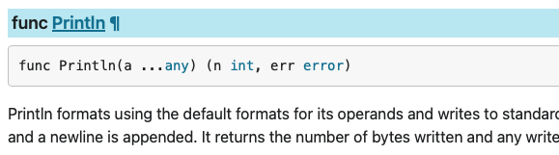

But how do we know whether the code is functioning the way it’s indicating?
To see the source, click the desired function.
Click!
Notes:
然後呢？
點進去看看

Slide 12
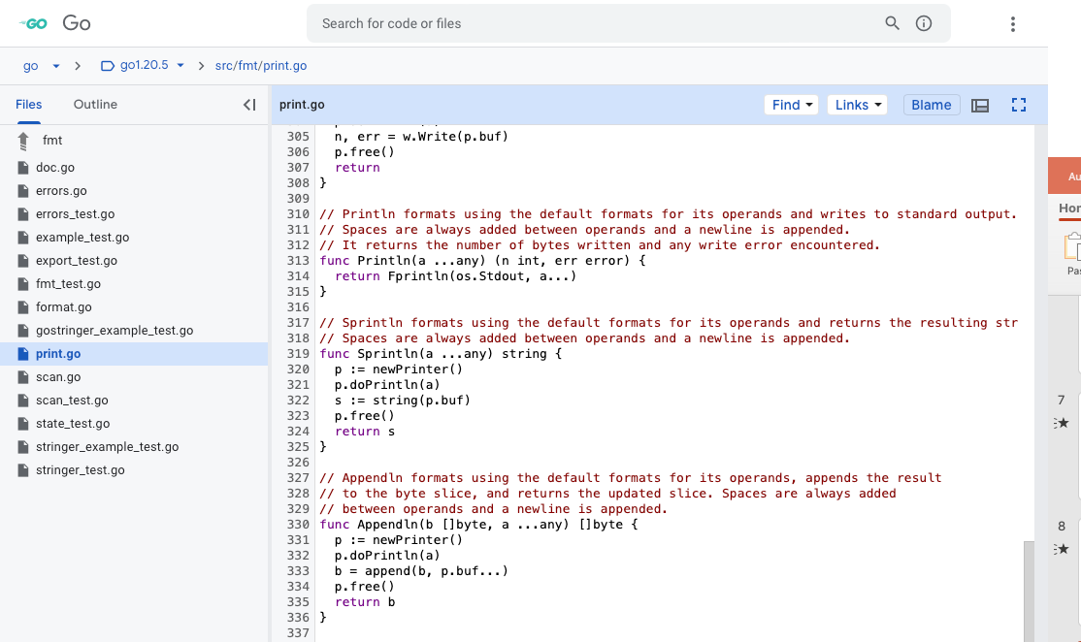
Finally, we’re at!
Since functions in Go is a first-class citizen, we see that the function is returning another function Fprintln(os.Stdout, a…)
Notes:
Go is not an object oriented language, nor a functional programming language. However functions are first class citizens in the language.

Slide 13
func Fprintln(w io.Writer, a…any) (n int, err error)

Slide 14
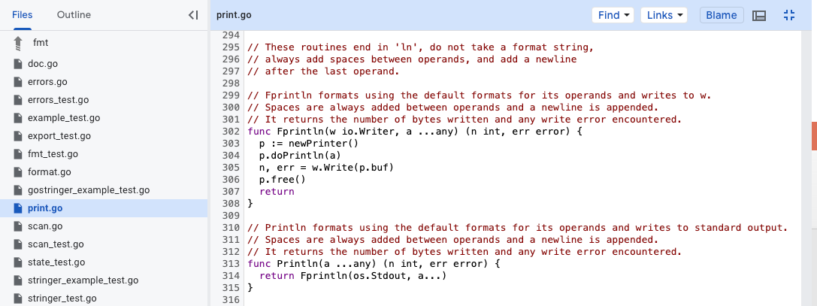
The underlying logic
Writes to w
Newline is appended
Return number of bytes written and any write error
Notes:
Explain document 投影片結尾：Let’s zoom in and check

Slide 15
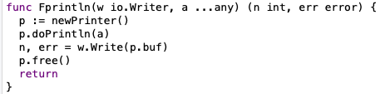
Input Values:
w (type io.Writer)
a… (type any)
Return Values:
n (type int)
err (type error)
Pattern:
newPrinter()
doPrintln(a)
w.Write(p.buf)
p.free()
Notes:
各種沒看過的東西，我們先快速走一遍，請大家記得現在看到的這張投影片。

Slide 16
Input Values

Slide 17
Input Values
w (type io.Writer)
a (type any)
a... means that it’s taking a Variadic variable

Slide 18
The io.Writer interface

Slide 19
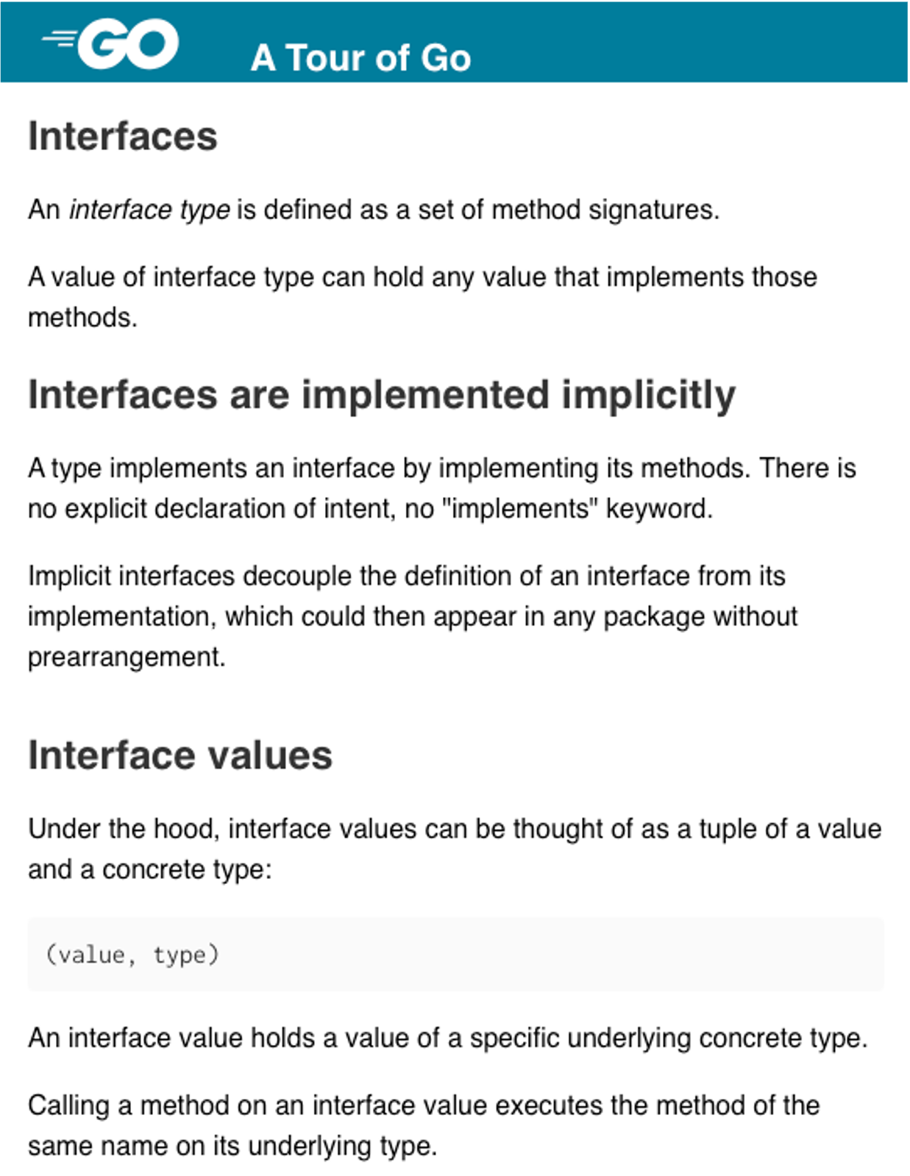
Interfaces
Implement by method => Anything that has the described method fits the interface type
A tuple of value and type => (value, type)

Slide 20
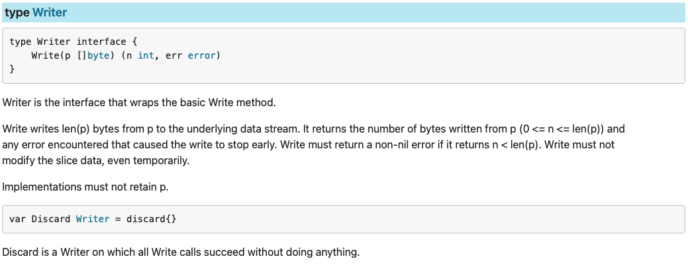
io.Writer interface
Anything that has Write(p []byte)(n int, err error) fits the type
Writes to the underlying stream
Returns the number of bytes written
Notes:
input: []byte
output: n, err
把p寫到指定stream去（啊如果想知道怎麼寫進去那就，有空自己往下鑽XDD, 這裡就不解釋了）

Slide 21
type any

Slide 22
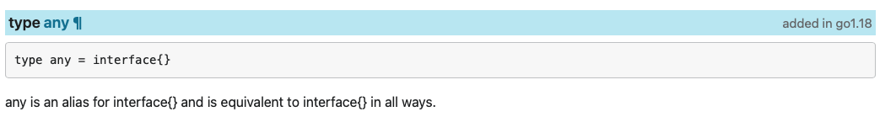
any
An alias of interface{}
All ways equivalent to interface{}
Notes:
是一個type喔！
所以傳進來的資料會被複製一份成interface type
String -> interface

Slide 23
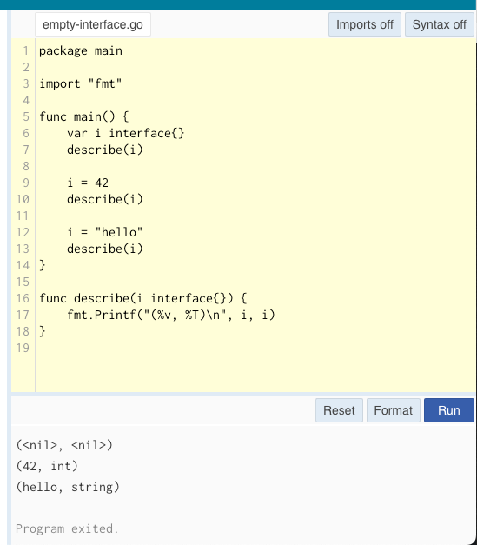
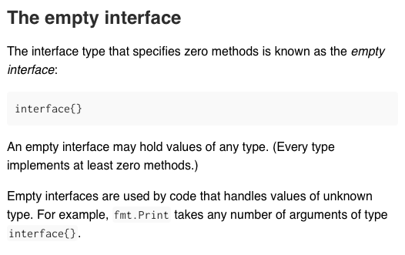

Slide 24
var foo any
Assign foo with a known type
(Built-in)
Assign foo with an unknown type
(Evaluated at runtime)
Variable | foo = 3.14
Value | 3.14
Type | float64
Variable | foo = &Person{}
Value | 0x12facr03
Type | *Person
Variables in Go
Notes:
Before i go on, i would like to explain variables in Go.
Since Go is statically typed, foo is a type interface{}, which has too slots for fitting, a value slot and a type slot.
The two values may vary when assigned to different variables(Remember that interfaces are abstractions of real objects, which they do not access the real value, but merely copying it)
Built-In: 跑的時候就認得
Unknown: 不認識的東西會用其他package處理，我們之後再說。

Slide 25
Variadic variables

Slide 26
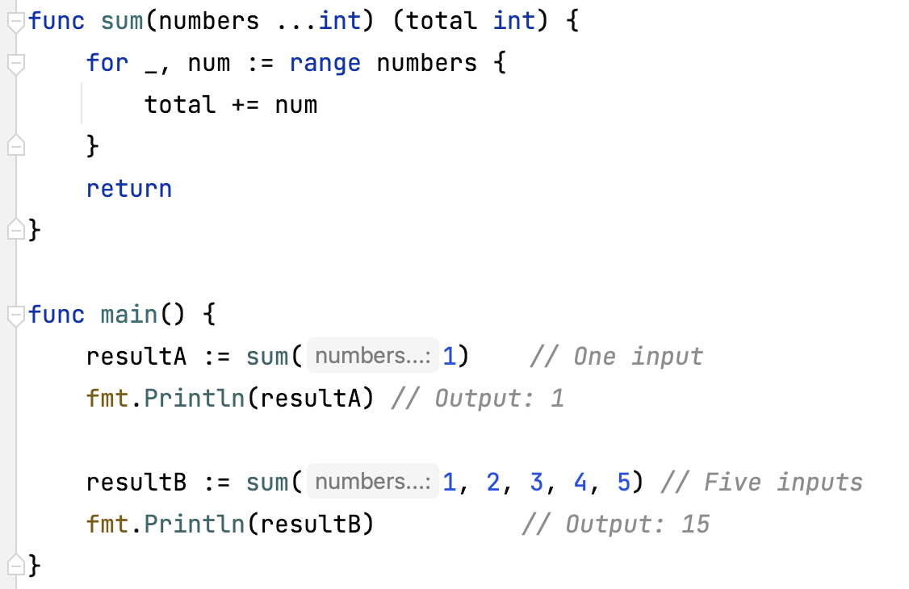
Variadic Variables
Denoted by ellipsis `…`
When pass arguments to a variadic parameter, they are automatically converted into a slice of the specified type within the function
Notes:
基本上就是Fancy Slice

Slide 27
Return Values

Slide 28
Return Values:
n (type int)
err (type error)
Notes:
有沒有種熟悉感，剛剛好像看過齁 （往前翻到writer那邊p20）。對，他直接回傳了Writer 寫完回傳的東西
那我們往會翻到fmt.Println()(p12),看一下他帶入的writer是誰

Slide 29
Pattern
Notes:
既然我們搞定input 跟output，那就剩pattern了

Slide 30
Pattern
What is the returned p from newPrinter()?
What is doPrintln(a) doing?
We know what w.Write() is, but what about p.buf?
p.free()?

Slide 31
What is the returned p from newPrinter()?

Slide 32
func newPrinter() *pp

Slide 33
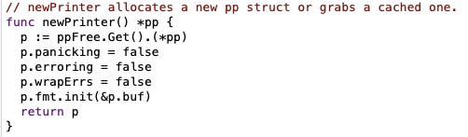
func newPrinter() *pp
Returns a type *pp
ppFree.Get().(*pp)
p.fmt.init(&p.buf)
Notes:
function newPrinter() 會從某一個快取空間去拿，拿不到的話看似會做一個？
不覺得 ppFree是個很奇怪的存在嗎（it's not declared in the function）(晚點再講)
Check with type cast .(type)

Slide 34
type *pp

Slide 35
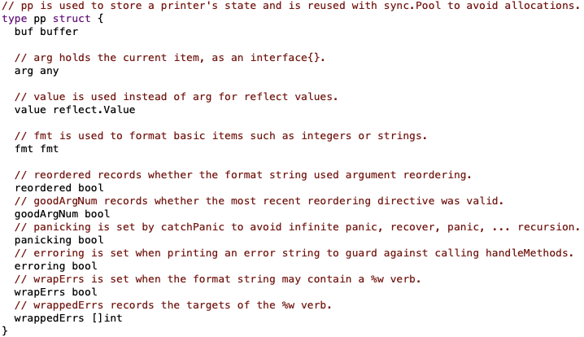
type pp
A stored printer state reused with sync.Pool.
Is a struct that is initialized with newPrinter, which is fetched from the pre-created pool ppFree or create when needed. Will be recycled after calling pp.Free()
Field buf (type buffer) is a buffer that holds []byte
Field arg (type any) holds the value passed in
Field value (type reflect.Value) is used when type is unknown
Field fmt (type fmt) is an ultimate formatter
Notes:
pp 就是那台影印機，裡面有很多參數可以設定

Slide 36
type buffer

Slide 37
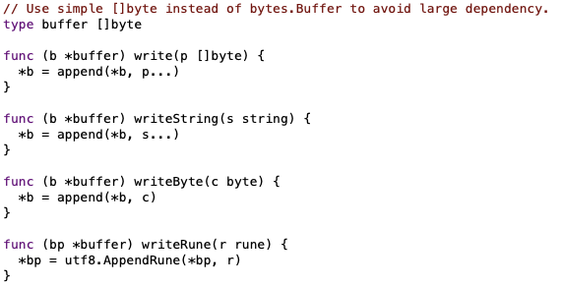
type buffer
Light weight buffer(byte slice) with only 4 methods
A byte slice that stores the done(formatted) result
The result is written to b

Slide 38
type fmt

Slide 39
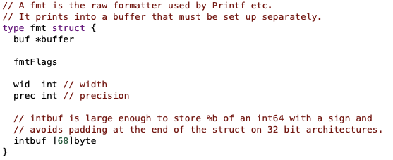
type fmt
Another struct within package fmt
A raw formatter
Field buf is a type *buffer
Prints into a buffer, which must be set up separately

Slide 40
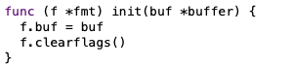
Field buf is set up together(by passing the address of p.buf) when calling newPrinter()
Now p and p.fmt shares &p.buf
The printer shares the storage with the printer engine!
Notes:
看看p.fmt.init()做了什麼

Slide 41
ppFree(type sync.Pool)
Notes:
還記得剛剛有個很奇怪的ppFree嗎？

Slide 42
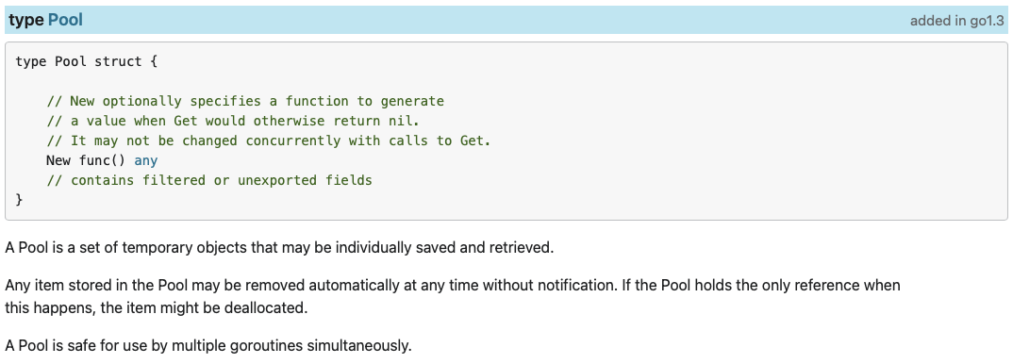
type sync.Pool:
Allocate a memory for storing one single unit, mostly in pointer form.
Used when frequently recreating an object. (Lift the burden from the garbage collector)
We can see that New() is its’ only field, which is a function type, API for user to call when there’s nothing in the pool.
Notes:
package sync 裡面的pool type

Slide 43
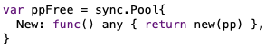
ppFree is a global variable allocated at startup
Uses new() as malloc for allocating struct address memories.(Which initializes all the fields with it’s zero value)
Notes:
原來ppFree是一個Global Variable.
在import package fmt後，程式啟動就會開一個pp（影印機）的空間。
我們接下來看看sync.Pool有什麼function

Slide 44
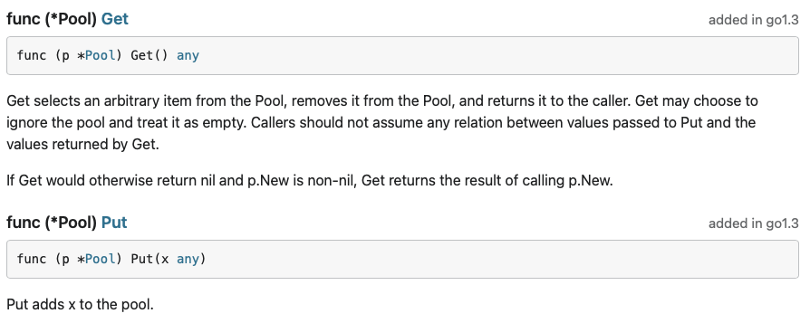
sync.Pool methods
Get() returns the result calling p.New() when there’s nothing in the pool.
Put() puts back the used x(which is what we fetched from the pool)
Notes:
不多，其實就兩個

Slide 45
Pattern
What is p?
What is doPrintln(a) doing?
We know what w.Write() is, but what about p.buf?
p.free()?
Ans: A printer
Ans: A storage. So in all w.Write() is the literal printing action, which from the storage p.buf
Notes:
回到Fprintln的pattern

Slide 46
p.Free()?

Slide 47
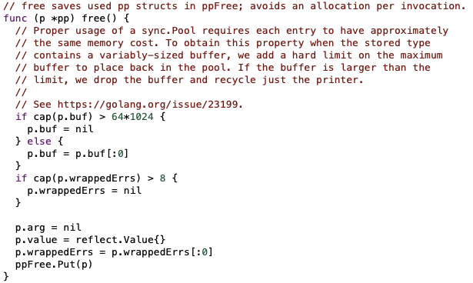
pp.Free()
Resets:
If buf size is valid, set buf to an empty byte slice, else set to nil.
p.arg
p.value
Set wrappedErrs to empty slice.
After reset, call sync.Pool method ppFree.Put() putting p back to ppFree.
Notes:
這邊buf size valid 我就不解釋了，reference 放在後面自己研究

Slide 48
Pattern
What is p?
What is doPrintln(a) doing?
We know what w.Write() is, but what about p.buf?
p.free()?
Ans: A printer
Ans: A cleaning mechanism which cleans the storage, clears all status(flags) and put the printer back onto the shelf(sync.Pool), waiting for the next call of newPrinter().
Ans: A storage. So in all w.Write() is the literal printing action, which from the storage p.buf

Slide 49
Half-way walkthrough
Notes:
走到一半了，複習一下

Slide 50
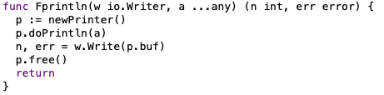
On start up (as long as you import package fmt), create ppFree(type sync.Pool), which have an inner method New(), initializes a pointer to type pp.
p.doPrintln(a)?
newPrinter()
p (type pp)
w.Write(p.buf)
p.free()
fmt (type fmt)
buf( type buffer)
arg (type any)
value
(type reflect.Value)

Slide 51
Pattern
What is p?
What is doPrintln(a) doing?
We know what w.Write() is, but what about p.buf?
p.free()?
Notes:
剛剛這一大串，剩一個問題了

Slide 52
What is p.doPrintln(a) doing?

Slide 53
How?
Since we analyzed the pattern, and apparently nothing else in the previous section is discussing about formatting, we assume that p.doPrintln(a) has something to do with it.

Slide 54
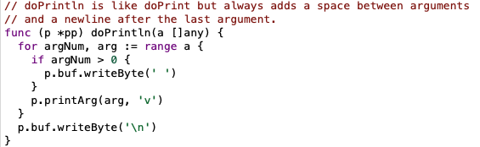
p.doPrintln(a):
Remember that in fmt.Println(a), a is a variadic variable of type any.
Create ‘ ‘ between arguments and writes ‘ \n’ at the end of everything.
Magic happens at p.printArg()
Notes:
記得剛剛說會再operands中間加空格，結束時加newline嗎?
這裡可以清楚看到用for loop走完全部，除了第一個element之外前面全部加空格，用的還是剛剛講buffer的四個function之一（翻回去p37）

Slide 55
pp.printArg(arg any, verb rune)

Slide 56
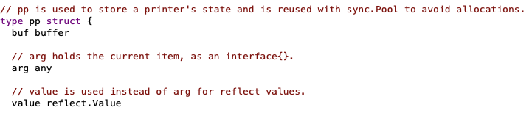
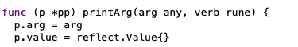
We assume that the passed in values are known types.
Thus, we first set p.arg as the passed in arg and set p.value as reflect.Value{}, so that if the type matches one of the known values, some magic function can deal with p.arg directly.
Notes:
剛剛for loop時的arg代入p.arg, 並暫時將p.value定為空值
那known type 有哪些呢

Slide 57
Known types

Slide 58
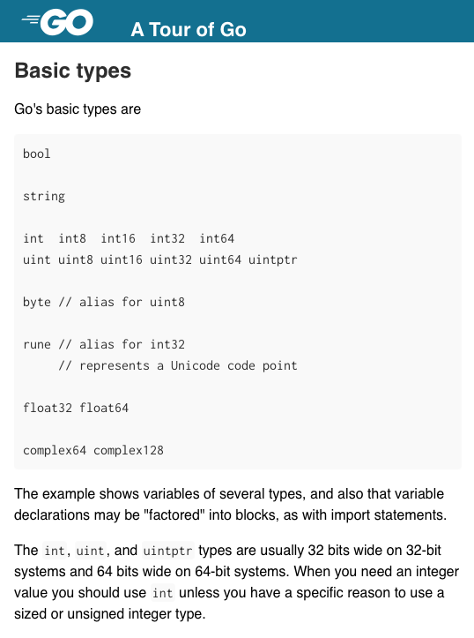
Built-in types (Known types)
Notes:
注意 map 跟chan, interface{} 等等都不在這裡

Slide 59
Known
Let’s use previous examples.
Notes:
所以這些是known type
map type?
chan type?

Slide 60
var foo any
Assign foo with a known type
(Built-in)
Assign foo with an unknown type
(Evaluated at runtime)
Variable | foo = 3.14
Value | 3.14
Type | float64
Variable | foo = &Person{}
Value | 0x12facr03
Type | *Person
Variables in Go
Notes:
Before i go on, i would like to explain variables in Go.
Since Go is statically typed, foo is a type interface{}, which has too slots for fitting, a value slot and a type slot.
The two values may vary when assigned to different variables(Remember that interfaces are abstractions of real objects, which they do not access the real value, but merely copying it)
Built-In: 跑的時候就認得
Unknown: 不認識的東西會用其他package處理，我們之後再說。

Slide 61
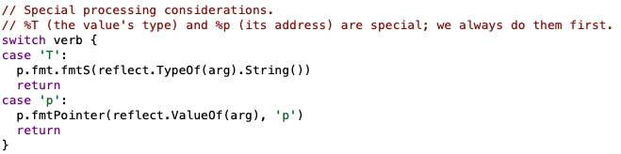
%T(the value’s type) & %p(it’s address):
We deal with it first before any other type checks.
Magic functions, we’ll discuss it later!
Notes:
先檢查verb, 這就是你fmt.Printf() 裡傳的%v %T 跟%p就會先處理

Slide 62
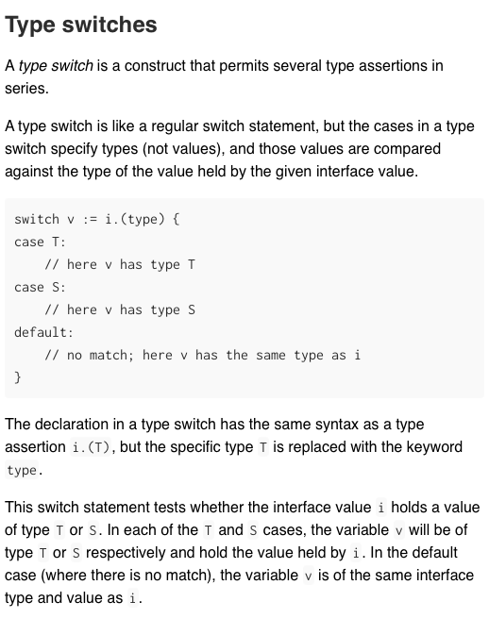
Type switches:
.(type) can only be used with switch
Is like type assertion ( .(int)…etc. ) and can fetch the value of the variable i using :=
Where there is no match, value and type doesn’t change
Notes:
.(type) 只能用在switch 裡
找不到的時候，值完全不變

Slide 63
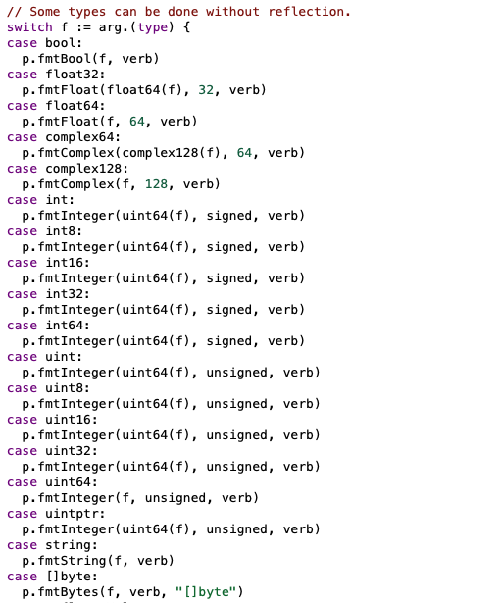
Known Types:
Use .(type) to switch through and decide what to do with the input data using magic functions
Notes:
Cannot check maps and channels

Slide 64
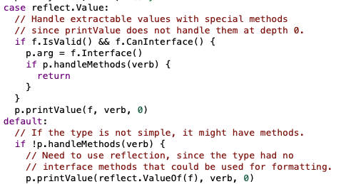
When there is no match, it’s an unknown type.
We deal it with another function p.PrintValue()
Notes:
先看是不是已經是reflect.Value interface(先不解釋), 不是的話（default）, typecast 兩個都叫p.PrintValue()

Slide 65
pp.printValue(value reflect.Value, verb rune, depth int)

Slide 66
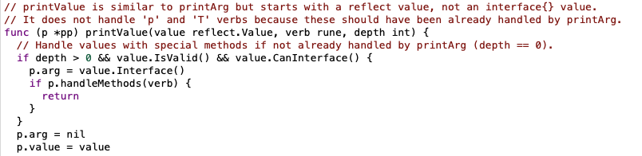
We now assume that the passed in values are unknown types.
Thus, we set p.arg to nil, then set p.value to value(which is some value we can’t deal with at the previous function).
Similarly, we type check again using switch, but this time checking the reflect type.
P and T shouldn’t be dealt here.
Notes:
因為剛剛不能處理的都被原封不動傳過來了

Slide 67
Unknown types

Slide 68
Let’s use previous examples.
Unknown
Notes:
Be aware of map and channel

Slide 69
Package reflect

Slide 70
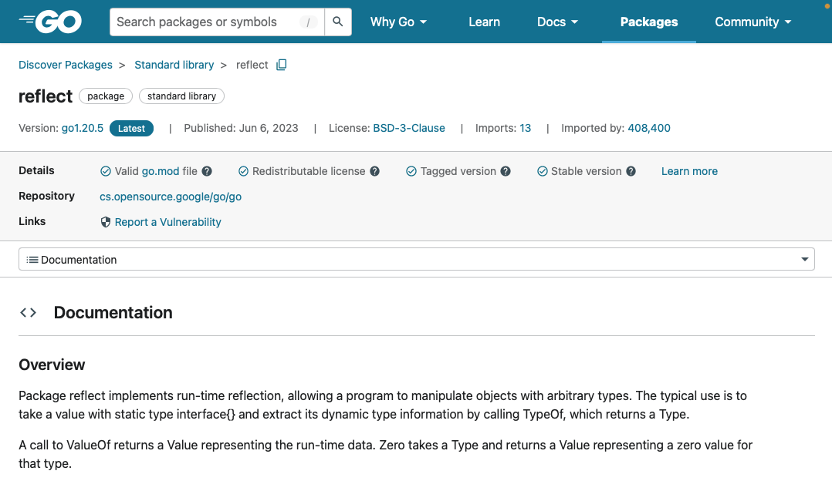
Package reflect
Runtime inspection
Takes static type interface{} as input
Used to check the slots of an empty interface
Notes:
我們看一下fmt怎麼做

Slide 71
var foo any
Assign foo with a known type
(Built-in)
Assign foo with an unknown type
(Evaluated at runtime)
Variable | foo = 3.14
Value | 3.14
Type | float64
Variable | foo = &Person{}
Value | 0x12facr03
Type | *Person
Variables in Go
Notes:
Before i go on, i would like to explain variables in Go.
Since Go is statically typed, foo is a type interface{}, which has too slots for fitting, a value slot and a type slot.
The two values may vary when assigned to different variables(Remember that interfaces are abstractions of real objects, which they do not access the real value, but merely copying it)
Built-In: 跑的時候就認得
Unknown: 不認識的東西會用其他package處理，我們之後再說。

Slide 72
Before dealing with print.Value(), check if value is already a type reflect.Value, if not, cast it with reflect.ValueOf()

Slide 73
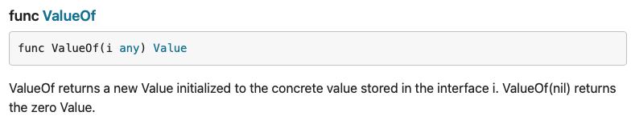
func reflect.ValueOf()
Returns a Value that fits the type reflect.Value interface

Slide 74
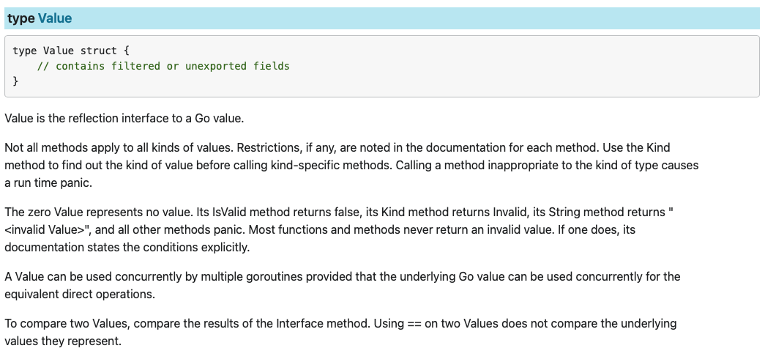
type reflect.Value
reflection interface to a Go value
Value that is assignable, addressable and exported can be assigned to the interface

Slide 75
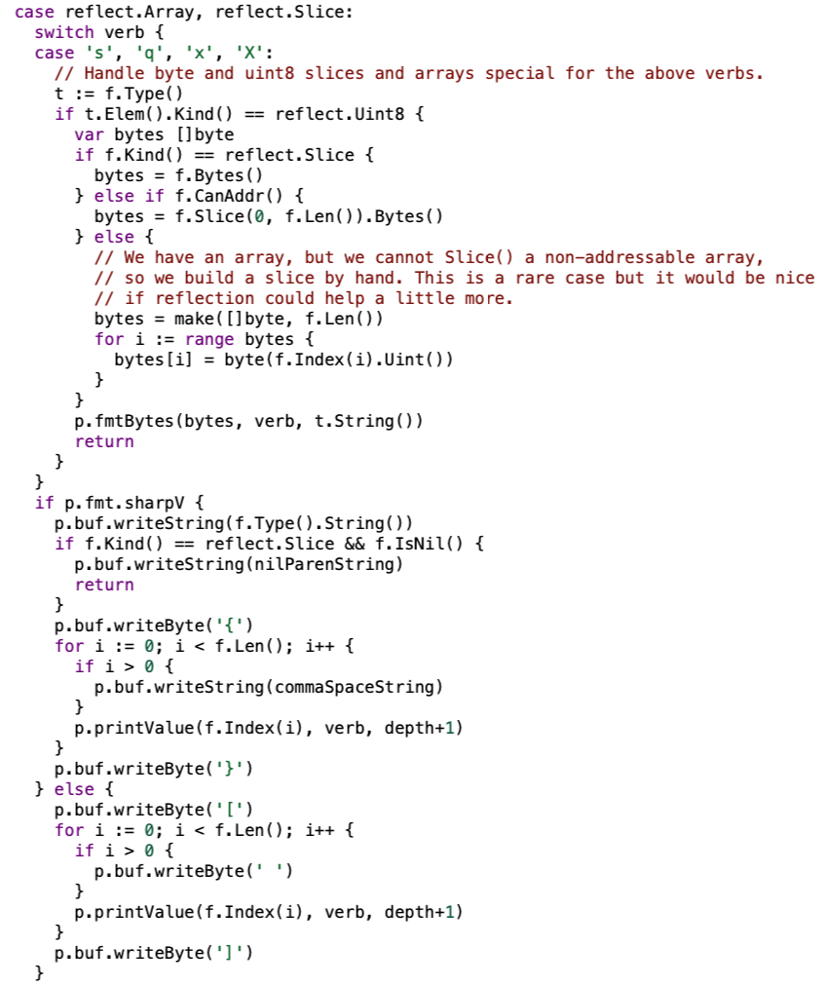
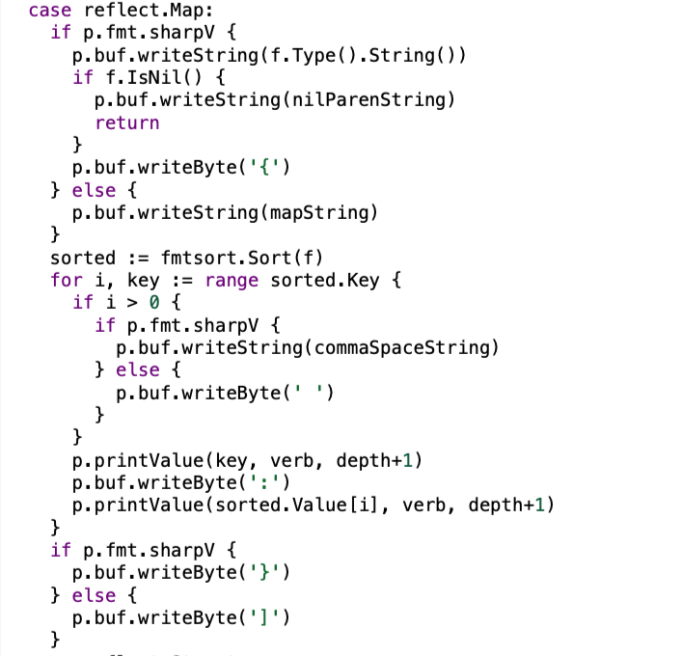
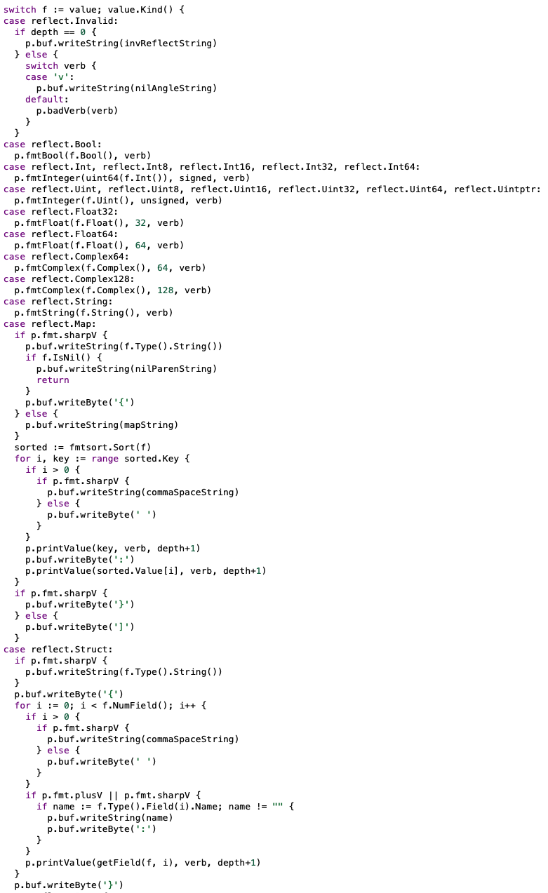
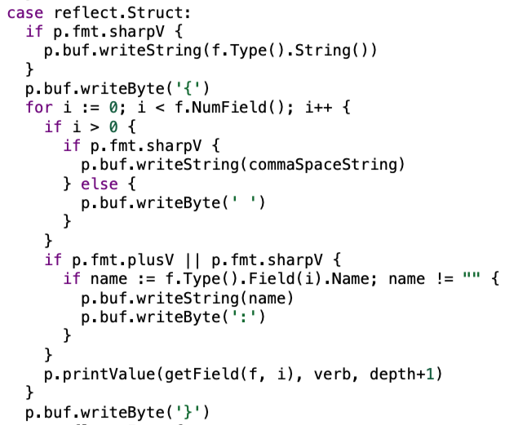
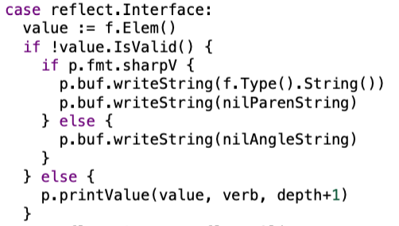
Type check with reflect.Value.Kind()
Use the checked type to determine which magic function to use
Notes:
Note that built-in types like map, channel, interface{}, struct{}, are evaluated using reflect.Kind()

Slide 76
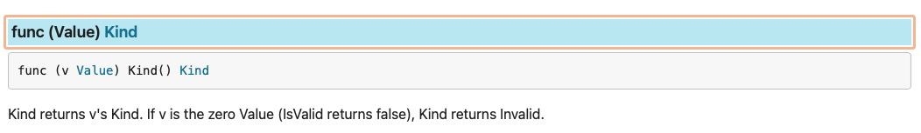
func reflect.Value.Kind()
Return reflect.kind (which is an iota)

Slide 77
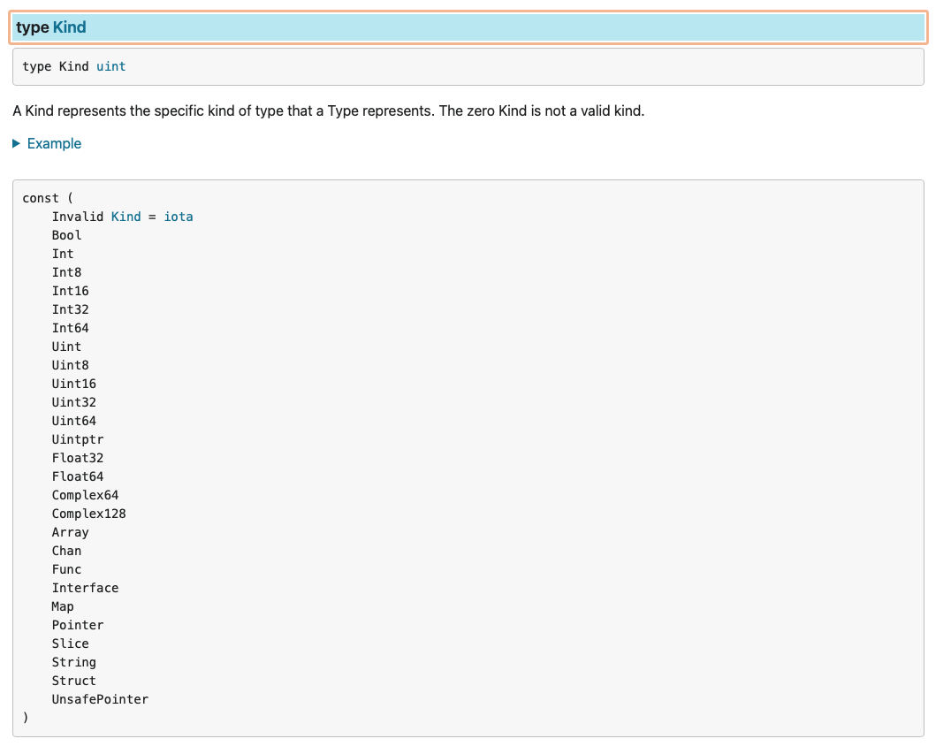
type reflect.Kind uint
iota based
Notes:
找到underlying的built-in type 後，繼續做該做的事

Slide 78
Magic functions

Slide 79
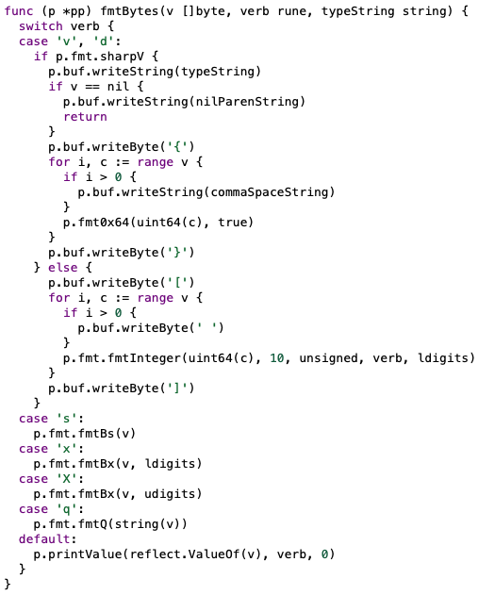
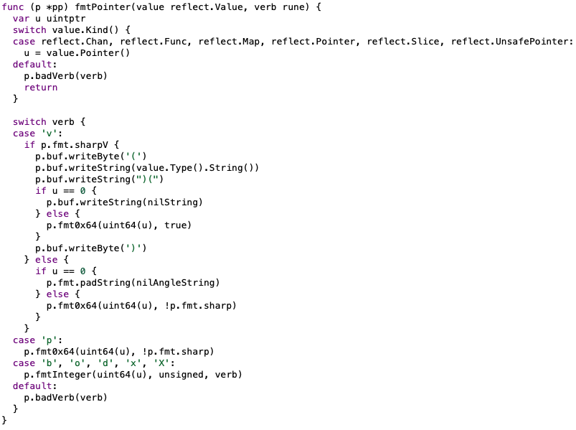
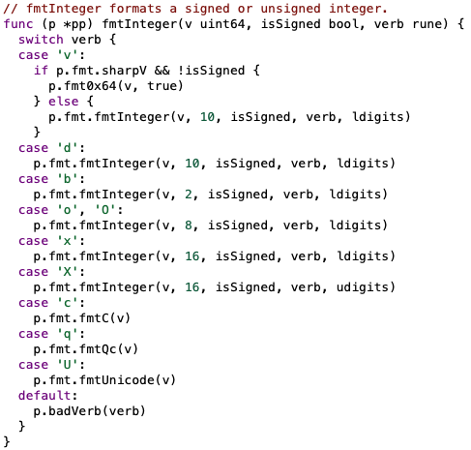
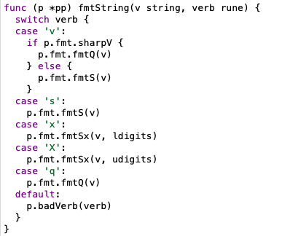
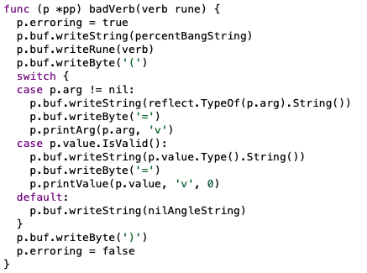




Deal with the given input
p.fmtBool
p.fmtInteger
p.fmtString
p.fmtFloat
p.fmtComplex
p.fmtBytes
p.fmtPointer
p.unKnownType
p.badVerb
…etc.
Notes:
These are the magic functions
這邊就請各位去研究細節了，太多一個小時講不完

Slide 80




Take p.fmtString as example
In fmt.Println(), the verb is v.
SharpV means verbs like “%+v”, “%#v”
Now we have the formatted string in p.buf (since f and p are sharing buf)

Slide 81
A total walkthrough

Slide 82
On start up (as long as you import package fmt), create ppFree(type sync.Pool), which have an inner method New(), initializes a pointer to type pp.
p.doPrintln()
=>
Super formatter engine, put data to p.buf(p.fmt.buf)
newPrinter()
p (type pp)
w.Write(p.buf)
p.free()
fmt (type fmt)
buf( type buffer)
arg (type any)
Built-In types => .(type) switch
Unknown types => cast with reflect.ValueOf(), then reflect.kind switch
value
(type reflect.Value)

Slide 83
Relatives
Notes:
這樣我們講完了fmt.Println()，我們看看他有哪些親戚

Slide 84

Print to stream (a designated writer)
Notes:
基本都是一樣的誒, printf 會要多處理verb

Slide 85


Print to value (have something to return)

Slide 86
My mindset tracing code

Slide 87

Know how the function works(as in how it functions)
Read the documentation of how to precisely use the function(what are the restrictions and when often the function is used)
See if there’s similar functions
Go to the source code
It might be daunting at first, give it a little time to sink in
Start asking questions(what is this doing this, how is that doing that)
Check the inputs and outputs, it’ll give a clue of what the function is trying to achieve
Use mind maps for Gods sake(unless you are super smart, and can remember everything)
Learn again and again
Worship how work are done in the most elegant way can be -> It’s ART!
This is what I’ve done for the presentation
Notes:
Sort the coding path out, ask yourself questions, answer them yourself

Slide 88
References

Slide 89

References for today's presentations
Go Standard Library
A Tour of Go: Interfaces
A Tour of Go: Interface Values
A Tour of Go: Empty Interfaces
A Tour of Go: Type switches
Sync: Pool example suggests incorrect usage
Go Language Reflection video series

Slide 90
And for fmt.Println(), it’s just printing.
Thanks for your listening =)
Notes:
Don’t care too much, this is a presentation of an example of tracing code.

Slide 91
Presentation Slide

Slide 92

Slides can be found on
https://github.com/wpted/Presentations/tree/main/20230629GoMeetUp_fmtPrintln

Slide 93



1.fmt.Print 和 print() 的差別, 為什麼分兩個
2.type Formatter interface 和 type Stringer interface 的差別, 一般日常開發感覺用不到前者
Stringer interface 只能純粹處理能轉換string的 但formatter可以底層接上fmt(只要你有Format() function), 可以自幹很多東西(比如說logger)，處理verb

